Slide 1
Analysis Of Forest Fire Predictors In Montesinho Natural Park
Miaozhi Yu
07/18/2016

Slide 2
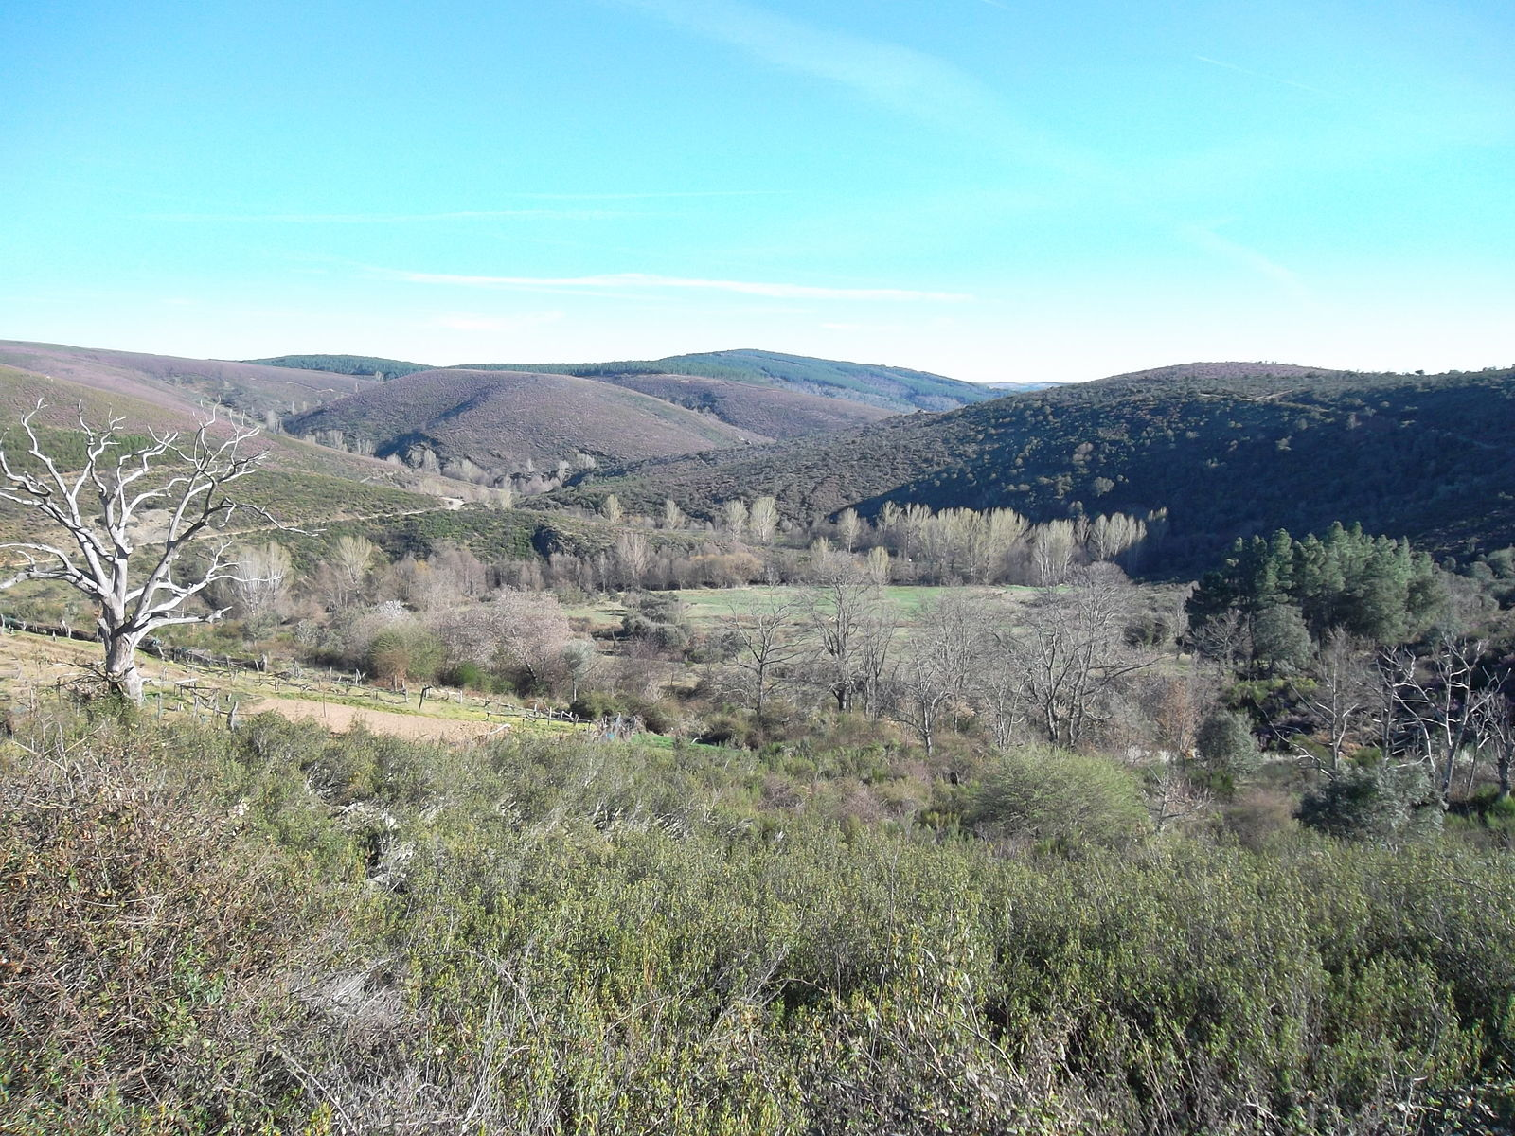
Montesinho is a natural park in Portugal

Slide 3
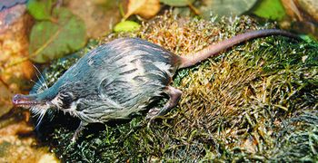
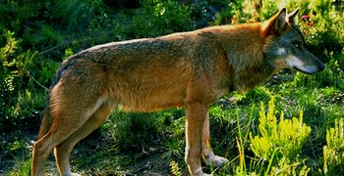

Home to many different kinds of animals

Slide 4
Montesinho Natural Park Forest Fire Data Forest Fire Data
Concerns burned area of the forests in Montesinho Natural park due to forest fire
Collected from January 2000 to December 2003
517 instances
13 variables (1 dependent variable, 4 discrete attributes and 8 continuous attributes)

Slide 5
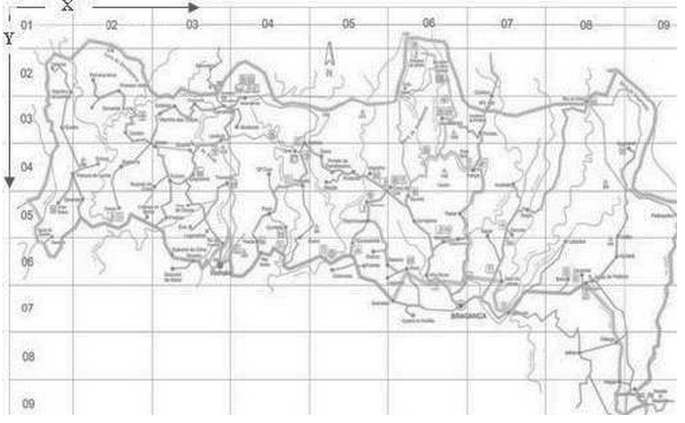
Basic Description
Response: area: Burned area of a forest fire (ha)
Predictors:
X: x-axis coordinate of the Montesinho park map: 1 to 9
Y: u-axis coordinate of yhe Montesinho park map: 2 to 9

Slide 6
Basic Description (Continued)
Predictors:
FFMC: A numerical rating of the moisture content of litter and other cured fine fuels: 18.7 to 96.2
DMC: A numerical rating of the average moisture content of loosely compacted organic layers and medium-size woody material: 1.1 to 291.3
DC: A numerical rating of the average moisture content of deep, compact, organic layers: 7.9 to 860.6
ISI: A numerical rating of the expected rate of fire spread: 0.0 to 56.10
Month: month of the year: 1 to 12
Day: day of the week: 1 to 7
Temp: temperature in Celsius degrees: 2.2 to 33.30
RH: relative humidity in %: 15.0 to 100
Wind: wind speed in km/h: 0.40 to 9.40
Rain: outside rain in mm/m2: 0.0 to 6.4

Slide 7
Questions
How is the forest fire distributed in the park?
What are the significant variables to predict forest fire?
How are these variables related to the area of forest fire?
What can we suggest tourists and fire department?
Future questions

Slide 8
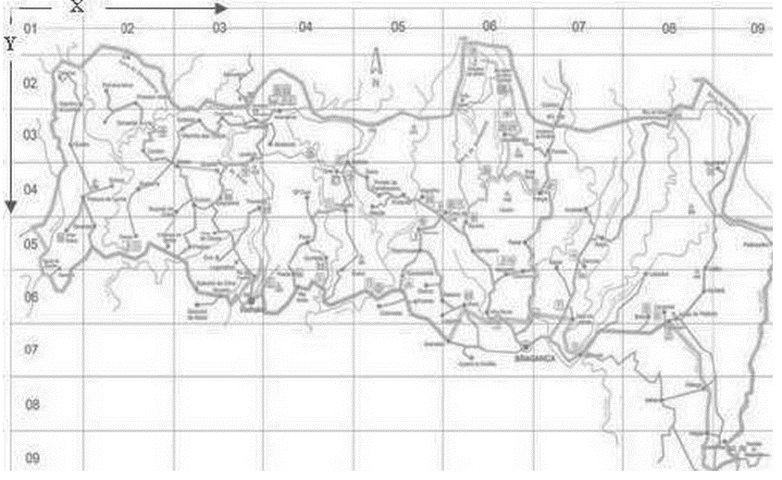
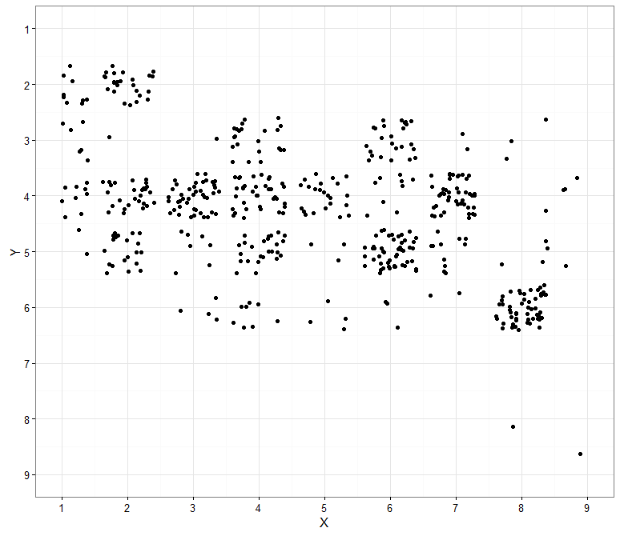
How the fire work distributed in the park

Slide 9
How large can the forest fire be?
summary(mydata_new$area)
Min. 1st Qu. Median Mean 3rd Qu. Max.
0.09 2.14 6.37 24.60 15.42 1091.00
Categorize area by the above information:
(0,2.14) size of area = ‘small’
(2.14,15.42) size of area = ‘median’
(15.42,1091.00) size of area = ‘large’

Slide 10
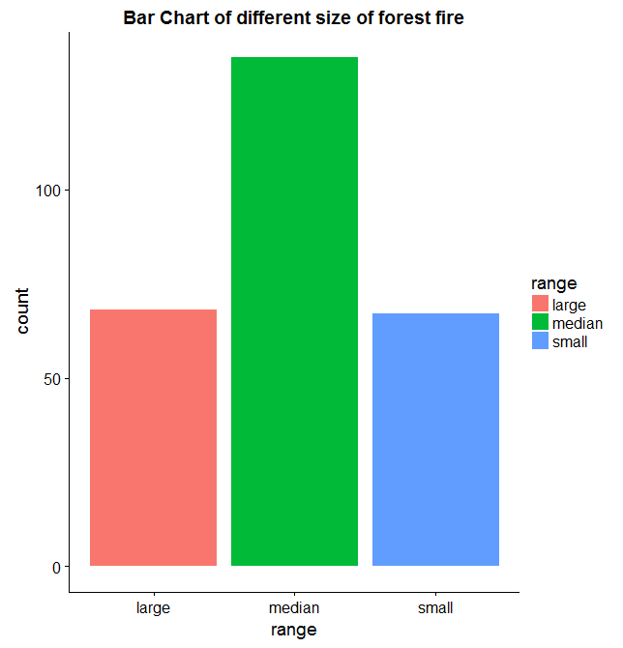

Slide 11
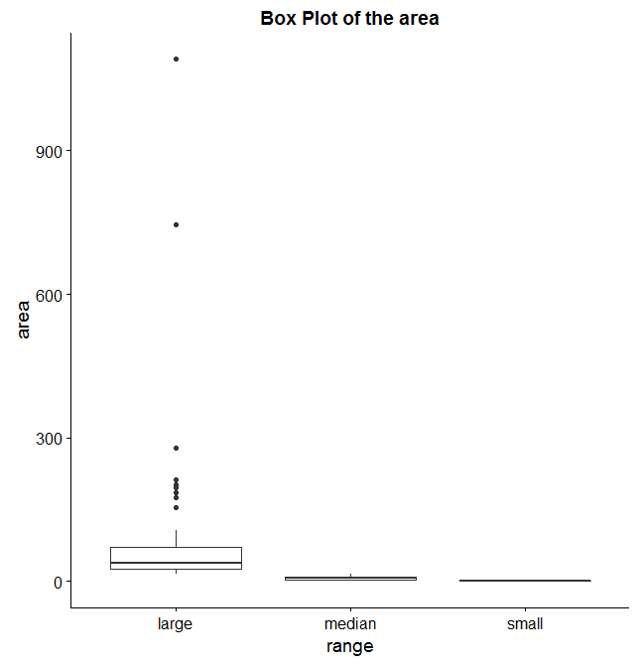
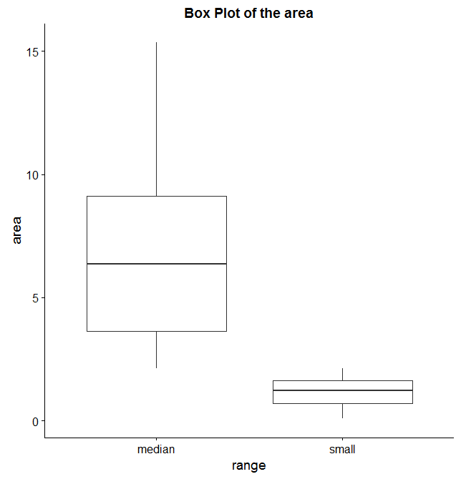

Slide 12
Which variables are significant?
fit = glm(log(area+1)~FFMC+DMC+DC+ISI+temp+RH+wind+rain,data=mydata_new,family=Gamma())
> summary(fit)
Call:
glm(formula = log(area + 1) ~ FFMC + DMC + DC + ISI + temp +
RH + wind + rain, family = Gamma(), data = mydata_new)
Deviance Residuals:
Min 1Q Median 3Q Max
-2.11417 -0.52704 -0.08414 0.28686 1.39097
Coefficients:
Estimate Std. Error t value Pr(>|t|)
(Intercept) 5.405e-01 6.776e-01 0.798 0.426
FFMC -2.129e-03 7.666e-03 -0.278 0.781
DMC -6.427e-04 3.960e-04 -1.623 0.106
DC 8.486e-05 1.036e-04 0.819 0.413
ISI 1.043e-02 6.706e-03 1.556 0.121
temp 7.194e-04 4.458e-03 0.161 0.872
RH 1.994e-03 1.420e-03 1.405 0.161
wind -1.043e-02 1.004e-02 -1.039 0.300
rain -1.099e-02 4.172e-02 -0.263 0.792

Slide 13
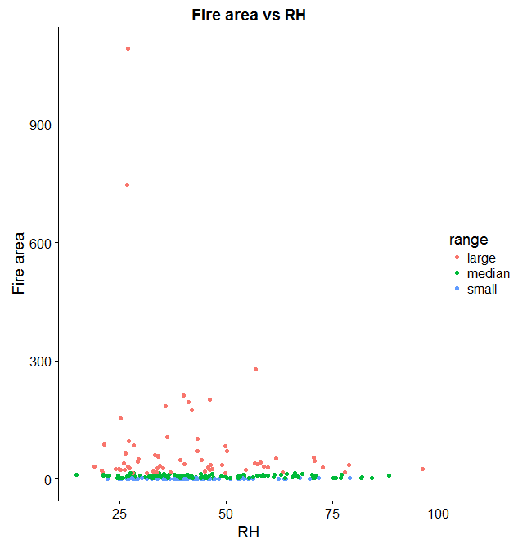
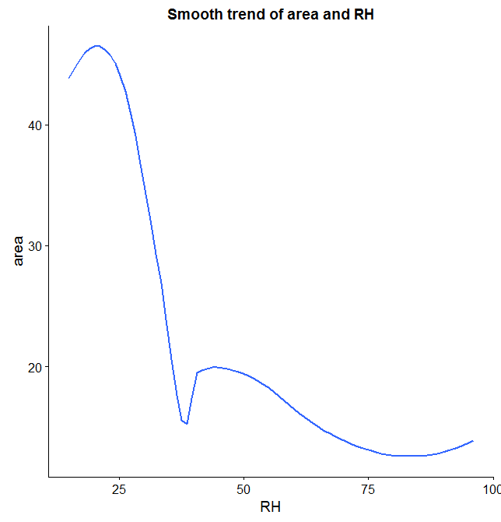
RH

Slide 14
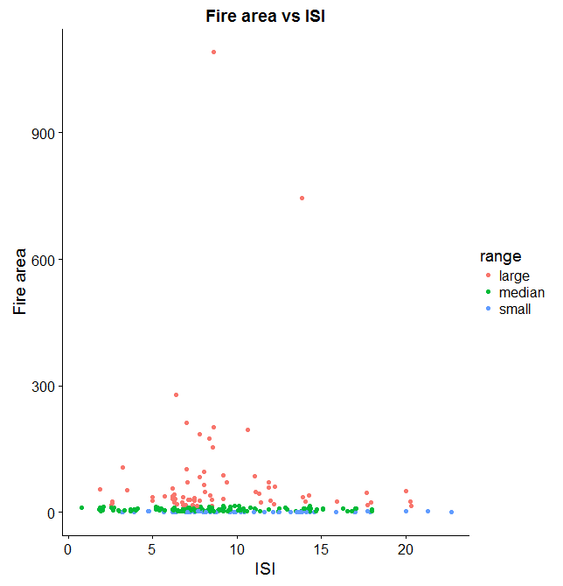
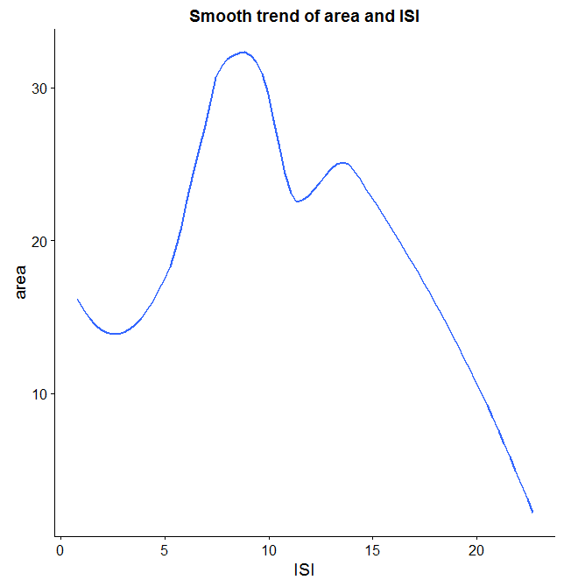
ISI

Slide 15
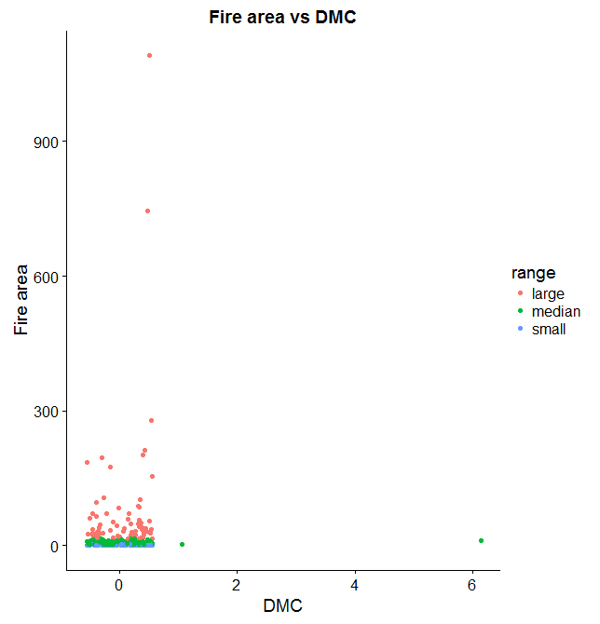
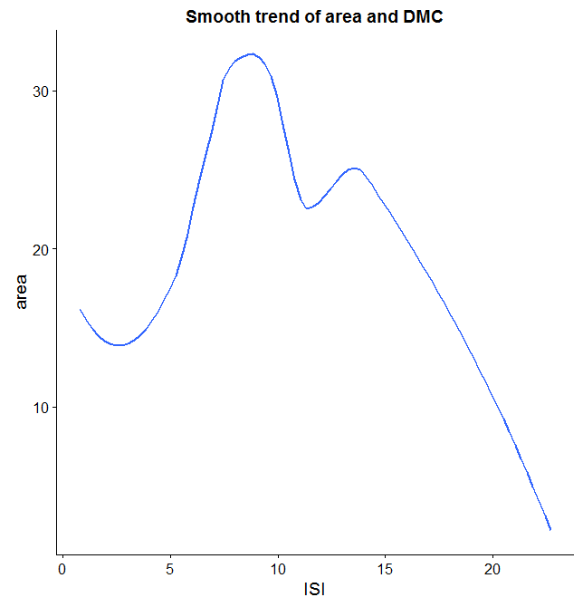
DMC

Slide 16
What can we suggest tourists and fire department?
Summer and Fall are the seasons when there are most tourists, thus we suggest tourists to be more careful when using fire (camping, BBQ etc)
The fire department should look closer at measurement of RH, ISI, DMC variables and prepare accordingly.

Slide 17
Future questions
How is the variables related to each other?
Can we give a more precise prediction of the area based on the variables we have now?

